Slide 1


Semester Project Final Presentation
Automated propeller geometry measurement
from 3d scanning data
LIS
Supervisors :
Professor D. Floreano
S. Steffen
A. Bhaskaran
Author:
P. Maury Laribière
Notes:
Automation propeller geometry measurement
From 3D scanning data

Slide 2
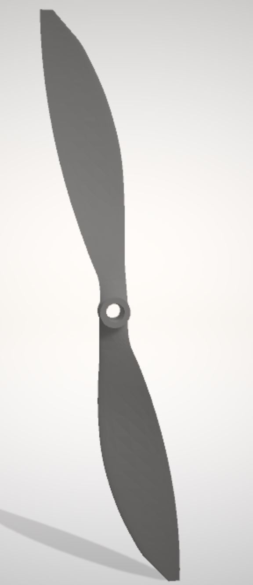
Outline :
Introduction
Goal of the project
Initial concepts
State of art
Methodology
Aerofoil shape
Parameters
Discussion
Conclusion
Notes:
First, introduce. Give prior info to understand following
Then, Methodology: 6 main steps
Discuss results and conclude

Slide 3
Introduction: Goal of the Project
Performance
analysis
Blade Element Momentum Theory
Shape
Problem :
Shape is not given
No common database
Notes:
Split in 2: 1 goal propeller. No common databse no professional 2 .solve problem analyze reverse engineering with 3d scanning
GOAL: create a tool to analyze performance of drone
Usually drone analysis with:
1. Wind tunnels (not practical)
2. BEMT (need shape) → not easily available. Not published by manufacturers
NEED: propeller shape to understand performance of drone
IDEA:
3D scan propeller → obtain point cloud of its surface → compute parameters and aerofoil shape on based → enable to use BEMT

Slide 4
Introduction: Goal of the Project
Shape
3D scanning
Project Goal
Analyze STL file
Output geometric parameters
Input for external software for further analysis
Solution :
Reverse engineer shape with 3D scanning
Notes:
GOAL: create a tool to analyze performance of drone
Usually drone analysis with:
1. Wind tunnels (not practical)
2. BEMT (need shape) → not easily available. Not published by manufacturers
NEED: propeller shape to understand performance of drone
IDEA:
3D scan propeller → obtain point cloud of its surface → compute parameters and aerofoil shape on based → enable to use BEMT

Slide 5
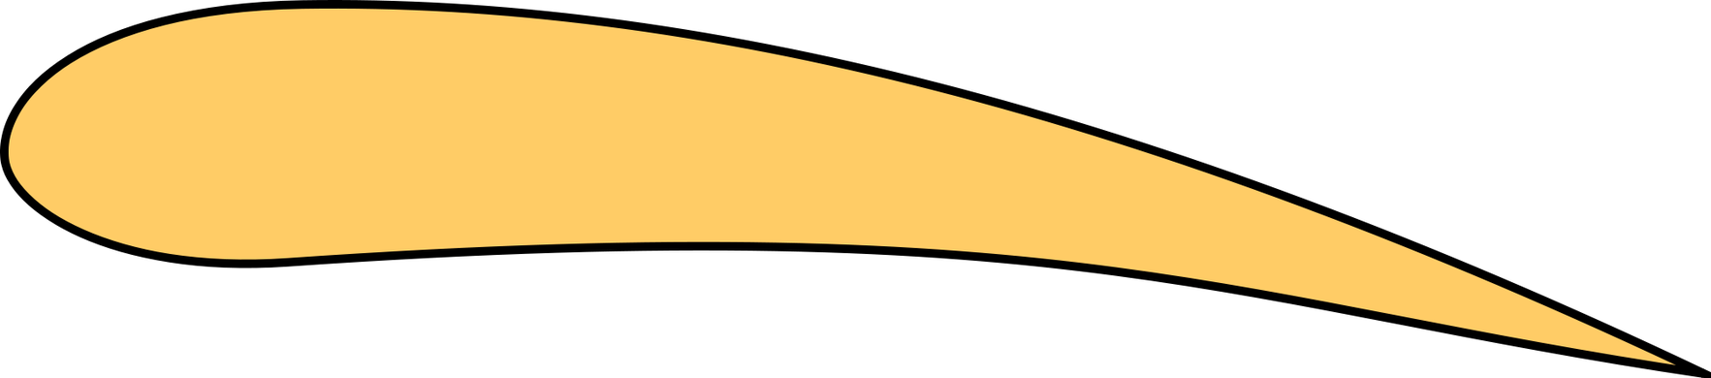
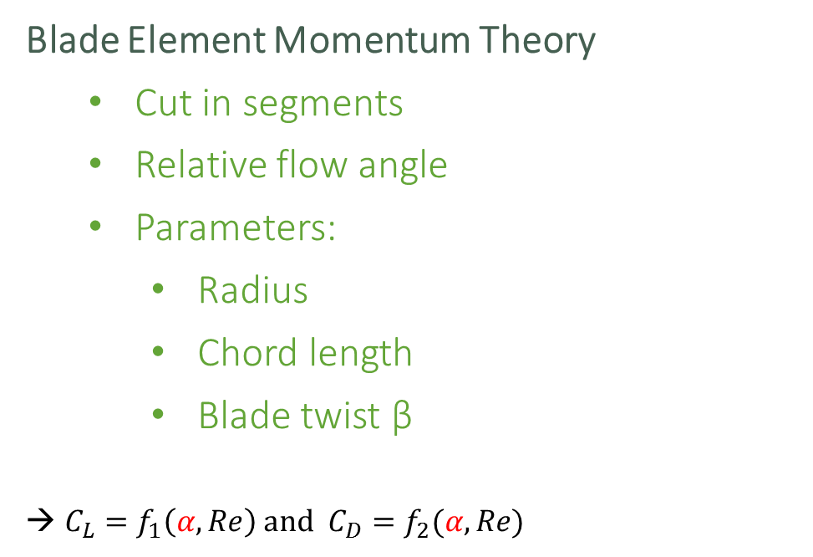
Introduction: Initial concepts
Blade Element Momentum Theory
Cut in segments
Relative flow angle
Parameters:
Radius
Chord length
Blade twist β
${C_{L}=f}_{1}\left(α, Re\right)$ and ${C_{D}=f}_{2}(α, Re)$
Lift
Air velocity
Drag
α = β - φ
β
φ
Rotation
Notes:
Nowadays drone perf analysis: BEMT.
cuts the propeller down into discrete segments along the radius
Estimate relative flow angle to blade segment WITH law conservation of momentum
Relative difference alpha of blade twist and air flow angle
→ Lift coeff: fct of alpha and Re
→ Drag coeff: fct of alpha and Re
→ Predict thrust and torques generated by segment by integrating over radius for all propeller
Method to predict performance of drone based on shape of propeller

Slide 6
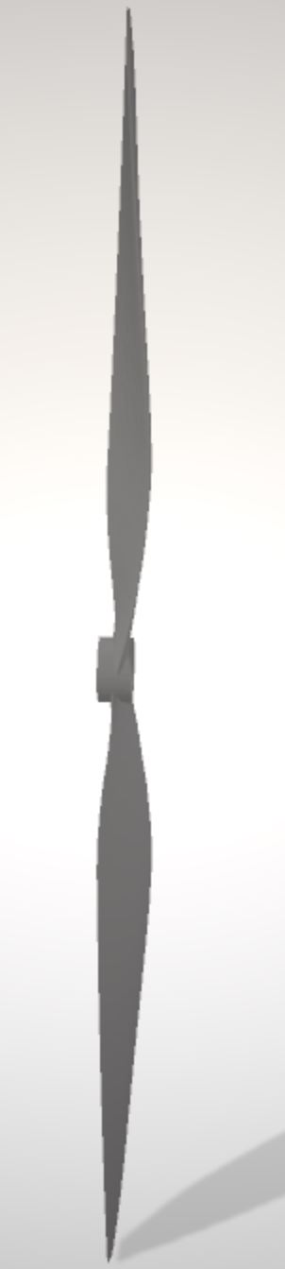
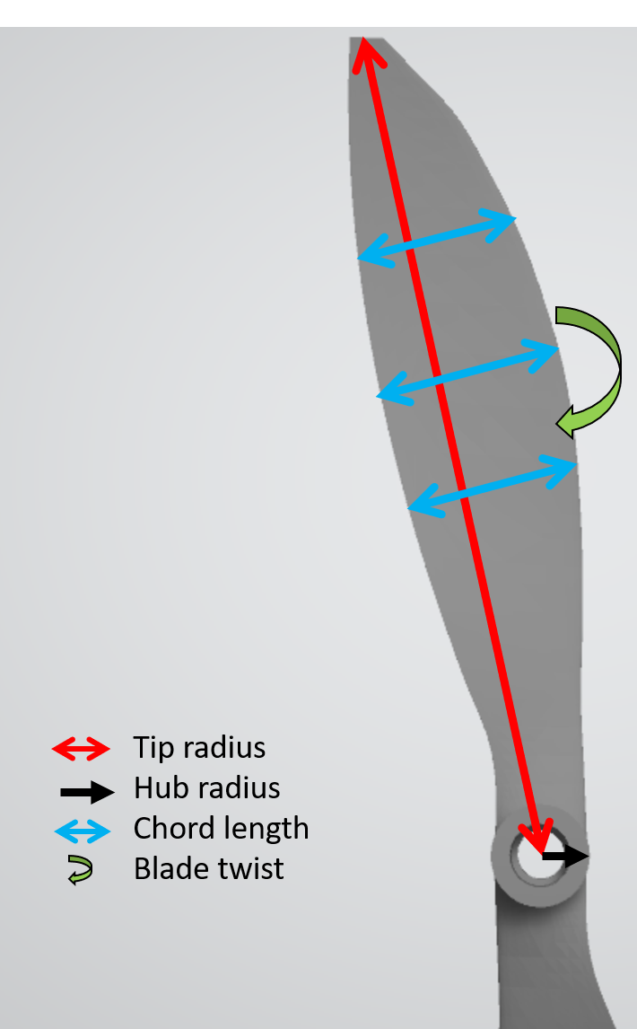
Introduction: Initial concepts
Important geometric parameters
Aerofoil
Chord length
Blade twist
Tip radius
Hub radius
Aerofoil
cross-section
Notes:
For a blade very important
Then possible external software (optionnal)
Project with propellers.
Explain main terms will use for parameters
Aerofoil = cross sectionnal shape of blade
Chord length = length ; Blade twist = angle wrt hub ; tip radius = length blade ; hub radius: central hole

Slide 7
Introduction: State of the art
Choices for 3D Scanning:
1. Contact
2. Non Contact Active
3. Non Contact Passive
CMM
[1]
Structured Light
[2]
Time of flight
[2]
Laser triangulation [2]
Photogrammetry
[3]
5 main techniques
Notes:
Again no datasheet available only solution is to scan ->different method
Say a little more about all
Photogrammetry most useful
Comparison table
Need a scanning method to generate point cloud. 5 main techniques to choose from
1. Contact : CMM: probe physically touches a firmly fixed object at several points and samples the different positions of the surface
2. Non contact active ----- rely on the emission of radiation or light.
Structured Light: a pattern of light. Measuring deformation of pattern on the object: shape deduced
Time of flight: Laser beam projected onto surface. Collected by a sensor. ToF of laser beam between its emission and reception provides geometrical information
Laser triangulation: Depending on distance object, reflected light falls at angle on receiving element. Determining spot position, distance object-receiver computed
3. Non contact Passive: Photogrammetry: reconstructs a 3D model object from 2D digital pictures taken at different angles (computer vision + computational geometry algorithm)

Slide 8
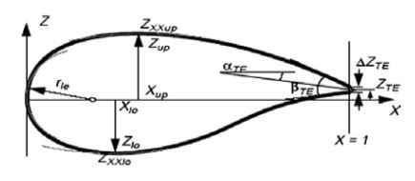
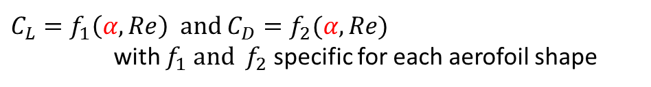
Introduction: State of the art
Cross section (= aerofoil shape) parametrisation
Bézier [4]
Parsec [4]
Sobieczky (with PARSEC) [5]
Improved Parameter Geometric [6]
4th Order Polynomial
Exemple : Parsec parametrisation
${C_{L}=f}_{1}\left(α, Re\right)$ and ${C_{D}=f}_{2}(α, Re)$
with $f_{1}$ and $f_{2}$ specific for each aerofoil shape
Fig 5: PARSEC parametrisation parameters [4]
Notes:
State shape of aerofoil affects the lift and drag of the section
Different aerodynamic èrperties of cross section shape
F1 and f2 specific to each shape
Add 4th order polynomial + comparison
Easy to implement
As better, used
Once scanning data, need to know how to parametrize aerofoil
Aerofoil = cross section
Many techniques which uses different features
Bezier: polynomials curves
Parsec parameters -- improved
Less parameters: IPG
Will try which is best to describe aerofoil obtained from point cloud

Slide 9

Introduction: State of the art
Comparison table for aerofoil parametrisation
 | Bézier | Parsec | Sobieczky (with Parsec) | IGP | Polynomial 4th order | Polynomial other order
Possible without first interpolating
Computable
Close shape representation
Notes:
State shape of aerofoil affects the lift and drag of the section
Different aerodynamic èrperties of cross section shape
F1 and f2 specific to each shape
Add 4th order polynomial + comparison
Easy to implement
As better, used
Once scanning data, need to know how to parametrize aerofoil
Aerofoil = cross section
Many techniques which uses different features
Bezier: polynomials curves
Parsec parameters -- improved
Less parameters: IPG
Will try which is best to describe aerofoil obtained from point cloud

Slide 10
Methodology : Algorithm Overview
Step 0:
3D scanning
(Photogrammetry)
Step 2:
Aerofoil Points selection
Step 1:
Propeller Pre-processing
Step 4 : Curves interpolation
(4th order polynomial)
Step 5:
Parameters computation
Step 6:
Point output for aerodynamic Software
Step 3:
Aerofoil Side assignment
Notes:
Step 0:output of scanning technique to step 1
6 main steps overview
STEP 1: Prepare for the following
STEP 2: Points selection: which points belong to which aerofoil ?
And then followed by this:
STEP3: to which side of the aerofoil do the point belong to ?
STEP4: following this step we can then use curve fitting tools to determine the optimal curve to describe each side of the aerofoil
STEP5: 4 parameters of blade
STEP6: Output point to use in Xfoil software to compute and compare drag and lift coefficients

Slide 11
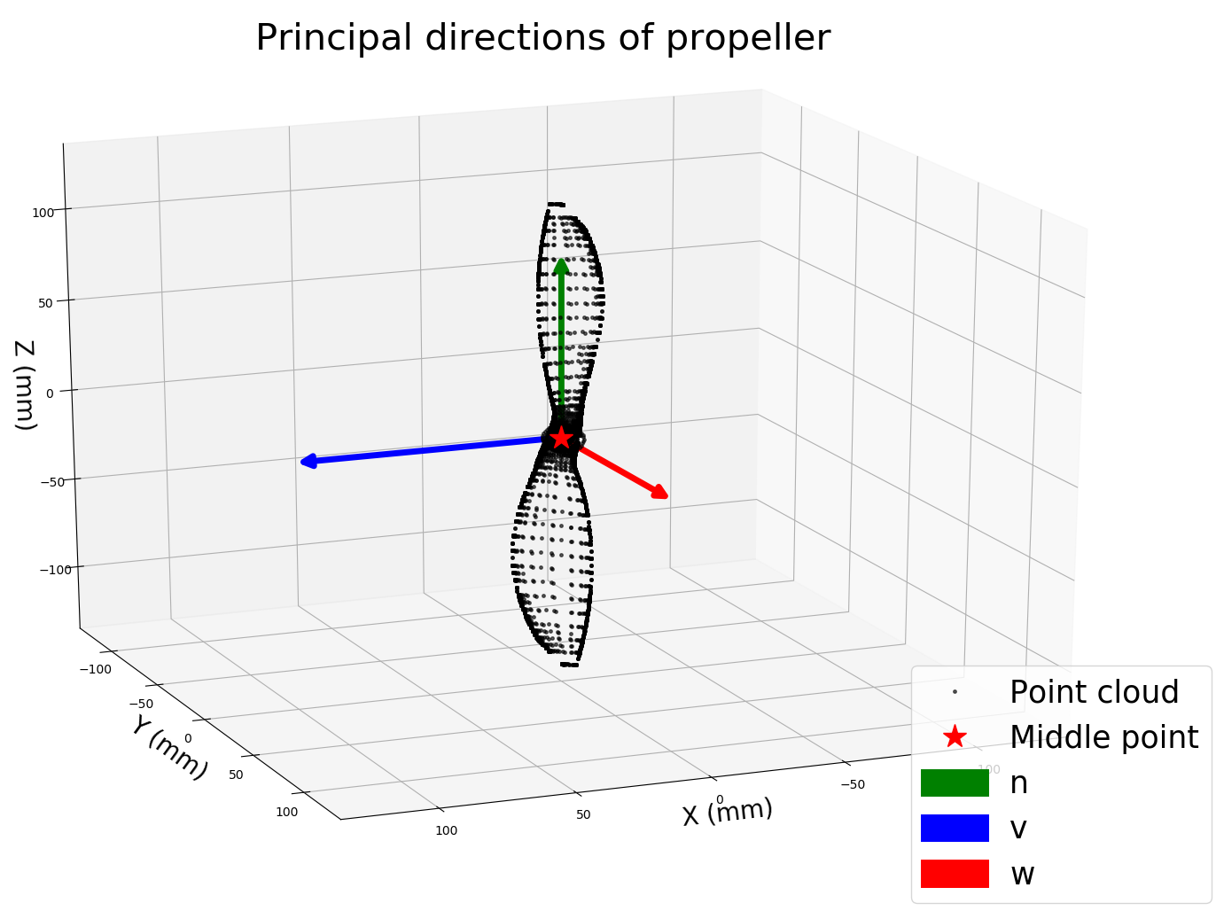
Methodology Step 1: Algorithm
Step 1: pre-processing
STL to CSV
Principal direction
Centering and rotating
Notes:
Removing redundant points

Slide 12
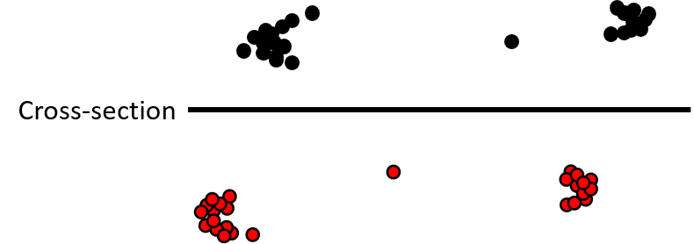
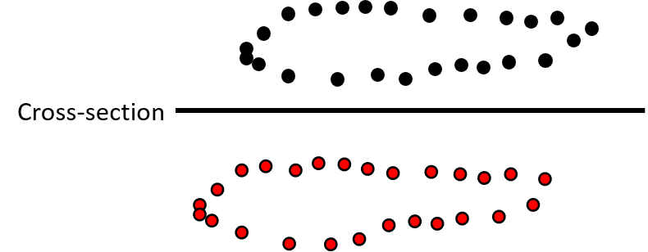
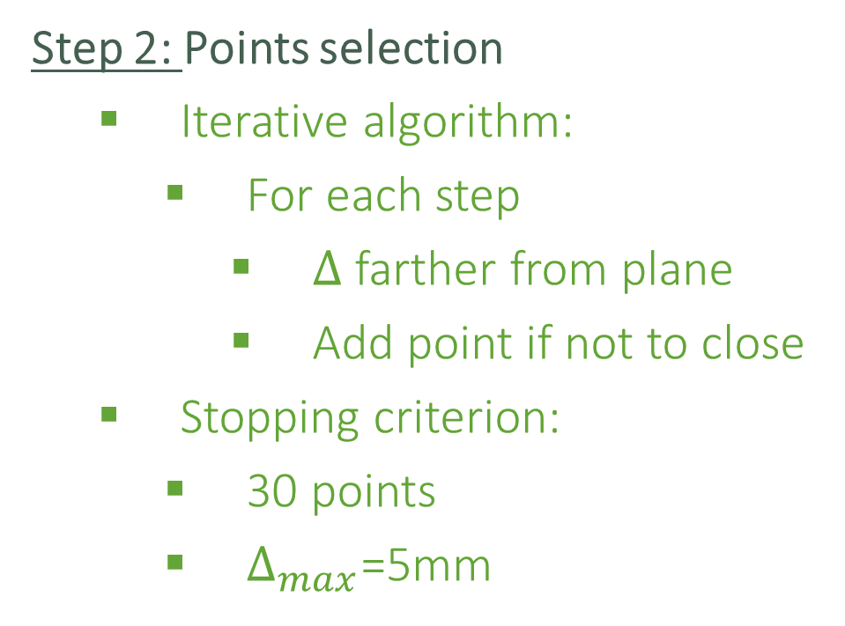

Methodology Step 2: Algorithm
Reality
Step 2: Points selection
Iterative algorithm:
For each step
$∆$ farther from plane
Add point if not to close
Stopping criterion:
30 points
$∆_{max}$=5mm
Above plane
Δ
Below plane
Goal
$$w_{min}=\frac{chord}{40}$$
Notes:
2d
Improve text
To wich aerofoil do which point belong to ?
And through this, we did iterative algorithm
Accuracy changed

Slide 13
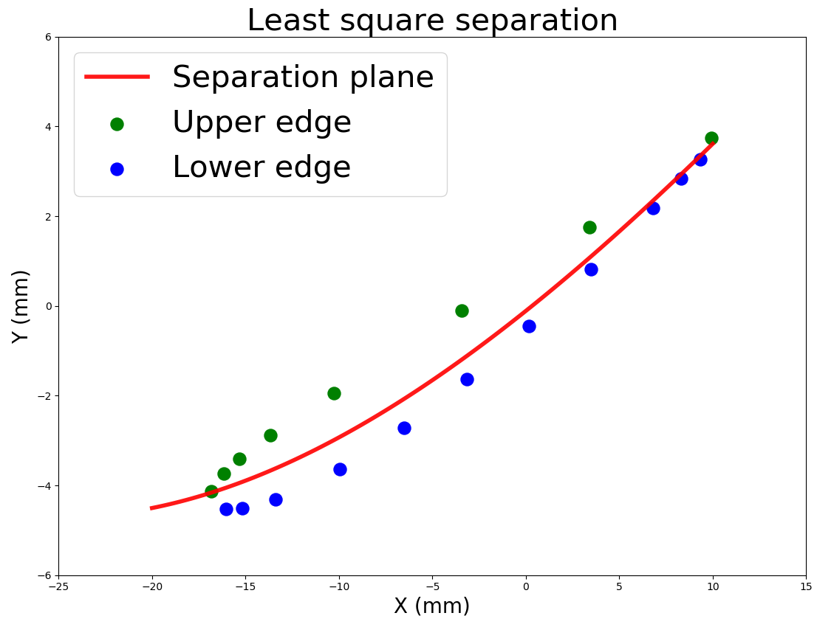
Methodology Step 3: Algorithm
Separation boundary
Lower surface
Upper surface
Step 3: Surface Separation
Least squares

Slide 14
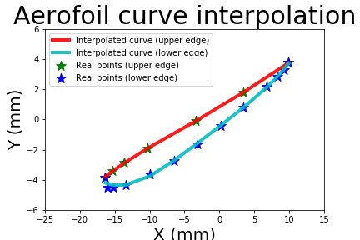
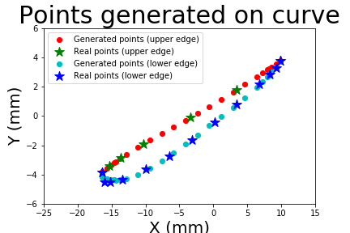
Methodology Step 4: Algorithm
Step 4: Curves interpolation (4th order polynomial) + continuity
Interpolated curve (lower surface)
Generated points (lower surface)
Interpolated curve (upper surface)
Real points (lower surface)
Real points (lower surface)
Generated points (upper surface)
Real points (upper surface)
Real points (upper surface)
Notes:
Why do this:the number not sufficient increase with interpolation and increase nb points in aerofoil boundary
Achieve continuity
How it should be done

Slide 15
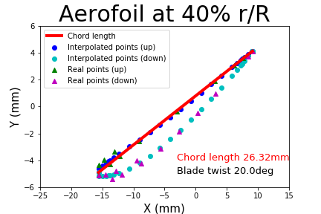
Methodology Step 5: Algorithm
Step 5: Parameters computation
Chord length
Blade twist
Blade twist angle
R
r = 0.4*R
Notes:
Propeller on top and make it staight and line at 40%
Draw ongle blade twist
Same scale
Chord length: length ranging from 1 side of the aerofoil to the other

Slide 16
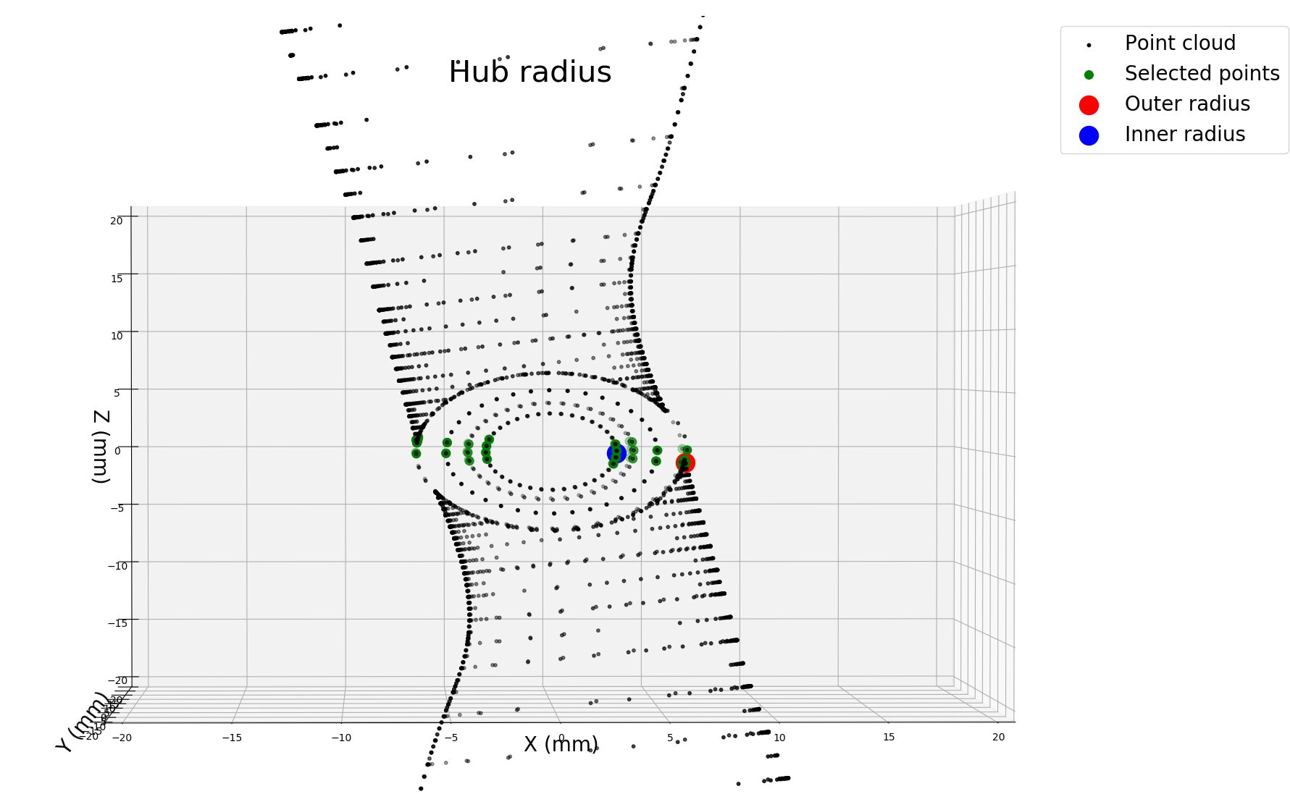
Methodology Step 5: Algorithm
Step 5: Parameters computation
Tip radius
Hub radius

Slide 17
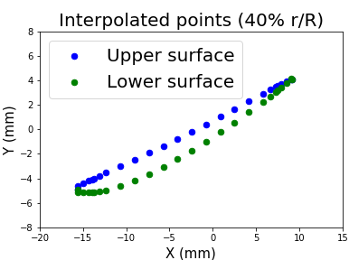
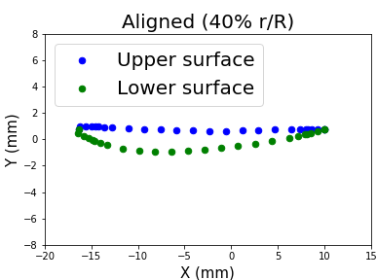
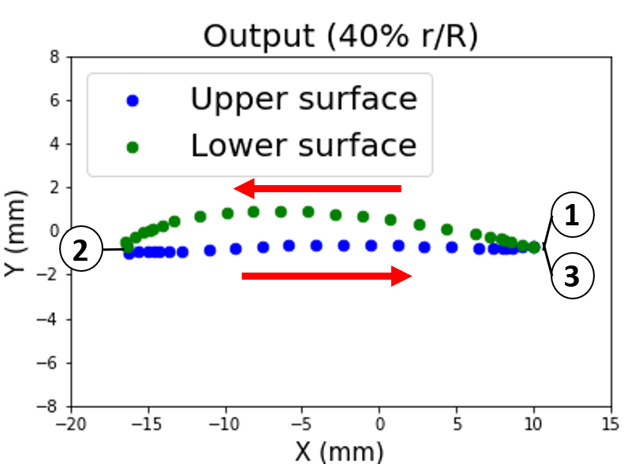
Methodology Step 6: Algorithm
Lower surface
Upper surface
Lower surface
Upper surface
Lower surface
Upper surface
Step 6: X-Foil output
Align, mirror, (normalize), right order
Reynold and Mach
Notes:
Upper = lower
Align = rotated
Overview reynold and mach properties: describe the energy of the speed of the flow. It affects aerodynamic properties

Slide 18
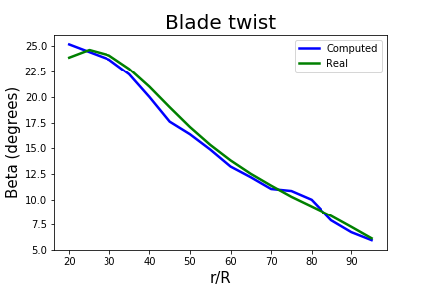
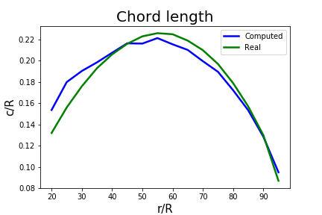
Results: Parameters
Chord length | Blade twist | Hub Radius | Tip Radius
RMSE 0.06 mm | RMSE 8.76 deg | Relative error 0.08 | Relative error 0.0015
 | Hub Radius | Tip Radius
Real | 7.15mm | 127mm
Computed | 6.54mm | 126.08mm
Notes:
Swap both
Actual values for 2 last
To conclude,
Goal: compute interesting parameter and shape information of propeller from 3D scanning data to be able to use BEMT on it
Done.
Still projections
Then Xfoil and parameters
Optionnal: find processes to further automate the 3D scanning of the propeller using examples of tools available on the market

Slide 19
Results: Aerodynamic Software
Blade parameters (Tip radius, Hub radius, Chord length, Blade twist)
Aerodynamic parameters (Reynolds and Mach numbers)
Points output for each aerofoil
Applicable in different aerodynamic software programs
E.g: X-Foil but did not converge in viscid mode
Notes:
Unfortunately there is no convergence in viscid mode such that the parameters can not be found in xfoil

Slide 20
Outcome of the project
Ability to adapt to different scanning methods (Step 0)
And formats (STL not optimal)
Variable accuracy with points selection (step 2)
Customizable polynomial interpolation method (step 4)
Ability to perform detailed analysis with external software
X-Foil not converging: continuity of both curves (?)
Future work: improve X-Foil or try other (Pablo [9], JavaFoil [10])
Notes:
Outcome
STL may be not the most appropriate format as the way it stores the shape of an object is through triangles. It leads to this problem where some parts are way more dense than others.

Slide 21
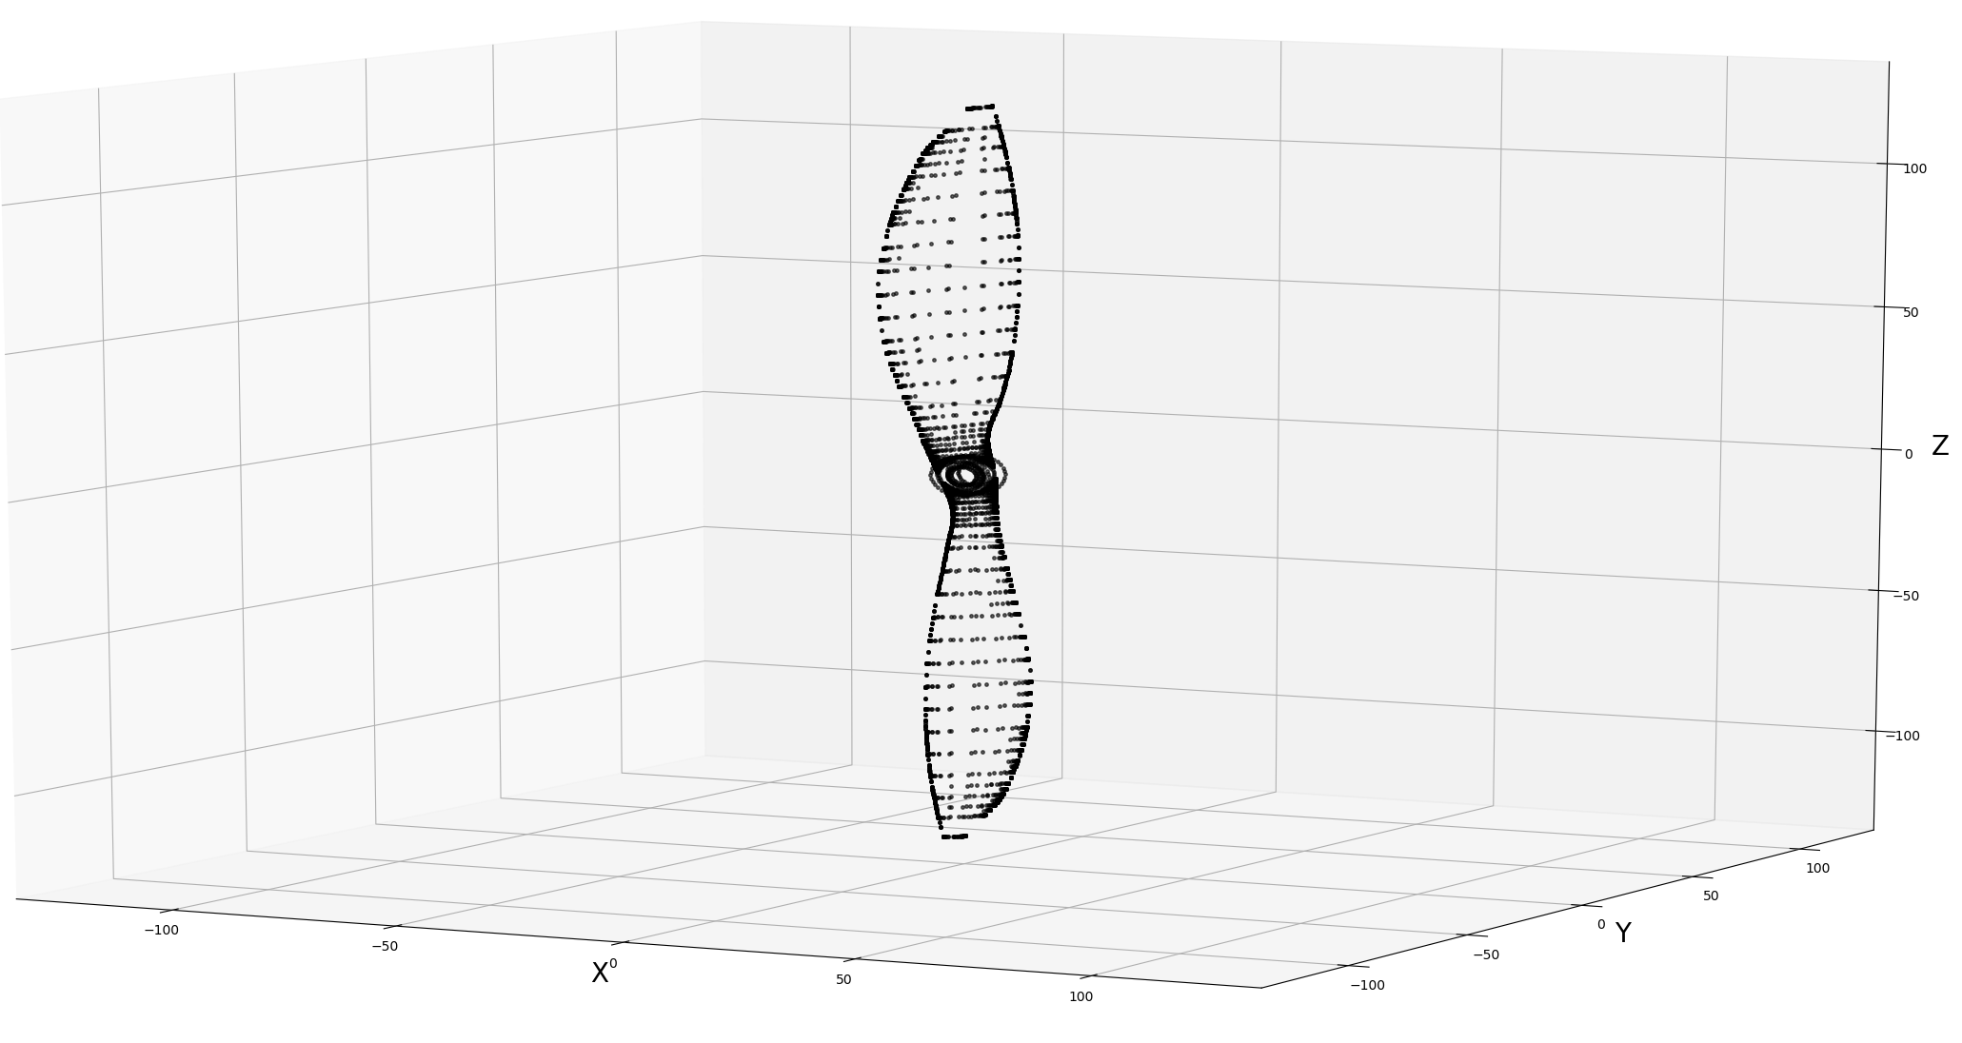
Conclusion
Reverse engineering algorithm for drone performance analysis
Aerofoil shape and parameters
New premises: scan and analyze
Compute performance
Reduce time at design phase
Notes:
State what have changed state of filed
Without: no way easily computing performnce with juste oject
Premise be able to scan and analyze, saving time at design phase
To conclude,
Goal: compute interesting parameter and shape information of propeller from 3D scanning data to be able to use BEMT on it
Done.
Still projections
Then Xfoil and parameters
Optionnal: find processes to further automate the 3D scanning of the propeller using examples of tools available on the market

Slide 22
Thank you for your attention

Slide 23
References
[1] A.W.L. Yao « Applications of 3D scanning and reverse engineering techniques for quality control of quick response products» Received: 2 October 2003 / Accepted: 27 January 2004 / Published online: 16 June 2004 © Springer-Verlag London Limited 2004
[2] Morteza Daneshmand, Ahmed Helmi, Egils Avots, Fatemeh Noroozi, Fatih Alisinanoglu, Hasan Sait Arslan, Jelena Gorbova, Rain Eric Haamer, Cagri Ozcinar, Gholamreza Anbarjafari. «3D Scanning: A Comprehensive Survey.» arXiv:1801.08863v1 [cs.CV] 24 Jan 2018
[3] Emmanuel P. Baltsavias. « A comparison between photogrammetry and laser scanning» Institute of Geodesy and Photogrammetry, Swiss Federal Institute of Technology, ETH-Hoenggerberg, CH-8093 Zurich, Switzerland Received 22 October 1998; accepted 17 March 1999
[4] Salunke, Nilesh P., Juned Ahamad R. A., and S.A. Channiwala. "Airfoil Parameterization Techniques: A Review." American Journal of Mechanical Engineering2.4 (2014): 99-102.
[5] Ava Shahroki Alireza Jahangirian Airfoil shape parameterization for optimum Navier–Stokes design with genetic algorithm. « Aerospace Science and Technology», Volume 11, septembre 2017
[6] Lu Xiaoqiang Huang Jun Song Lei Li Jing «An improved geometric parameter airfoil parameterization method.« Aerospace Science and Technology, Volume 78, July 2018
[7] from https://i.stack.imgur.com/Wo8E2.jpg
[8] from Ghassemi, H., & Zakerdoost, H. (2017). Ship hull–propeller system optimization based on the multi-objective evolutionary algorithm. Proceedings of the Institution of Mechanical Engineers, Part C: Journal of Mechanical Engineering Science, 231(1), 175–192. https://doi.org/10.1177/0954406215616655
[9] Pablo software: http://www.pdas.com/pablo.html
[10] JavaFoil Software: http://www.mh-aerotools.de/airfoils/javafoil.htm

Slide 24
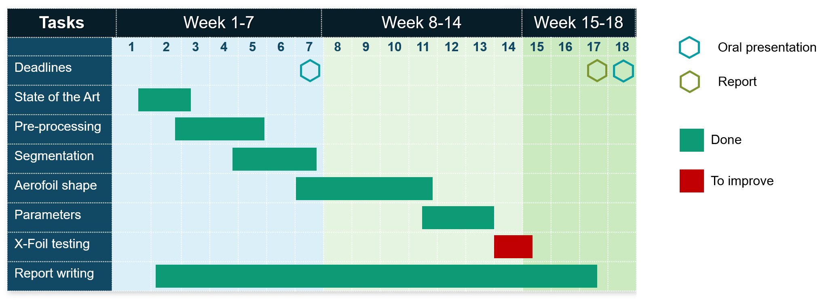
Gantt Chart

Slide 25
Ignore this page, will remove later
MORE professonial drones
Point cloud into more useful parametrization
Output can be use for other programs drag..accurate modelling
Goal of project is mainly to analyze stl file + parameters and if possible input in external software for further nalysis
Decode stl
Get parmeters
Input for others software
Althiugh xfoil common, some reason input doesnt converge. Accuracy
Strong reason
Notes:
Split in 2: 1 goal propeller. No common databse no professional 2 .solve problem analyze reverse engineering with 3d scanning

